Slide 1
EMPLOYEE MANAGEMENT SYSTEM

Slide 2
PROJECT DEFINATION
Employee management system will digitally stored all the records of the employee.
The employee records like personal details, joining records, transfer records, promotion records,salary and increment details, service history etc. will be managed digitally.
At present, all the records of the employee are maintained manually.
The system is less effective to keep the up to date records of the employee.
This process is time consuming and error-prone. Digital record keeping will make it more reliable ,transparent and effective.

Slide 3
Instructions for use
1. ABOUT ME.
2. ABSTRACT.
3. CONTENTS.
4. PROGRAMMING LANGUAGE.
5. CODE.
6. EXPLANATION.
7. OUTPUT.

Slide 4
HELLO!
NAME :- DHAIRYA JADAV.
ENROLLMENT NO :- 21162101008.
BATCH :- 31.
BRANCH :- CBA.
SUBJECT :- OOP.

Slide 5
1.
ABSTRACT

Slide 6
This report includes a development presentation of an information system for managing the staff data within a small company or organization. The system as such as it has been developed is called Employee Management System. It consists of functionally related GUI (application program) and database. The choice of the programming tools is individual and particular.

Slide 7
2. CONTENTS

Slide 8
CONTENTS
Information system.
Database System.
DBMS.
Parent Table.
Child Table.
Primary key.
Foreign Key.
SQL Queries.
Object Class.
If else.
Switch case.
Loop.
Exception Handling.
File Handling.

Slide 9
3. PROGRAMMING TOOLS

Slide 10
PROGRAMMING LANGUAGE AND TOOLS

Slide 11
4. CODE

Slide 12
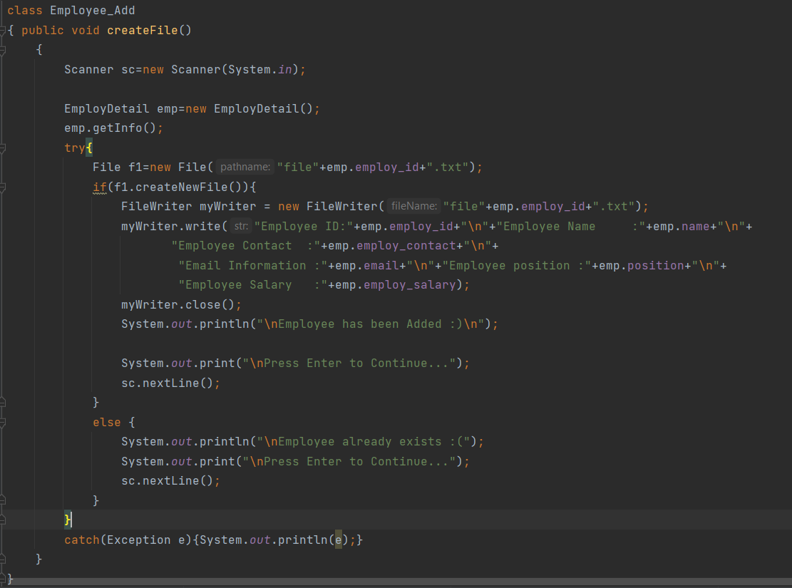
TO ADD AN EMPLOYEE

Slide 13
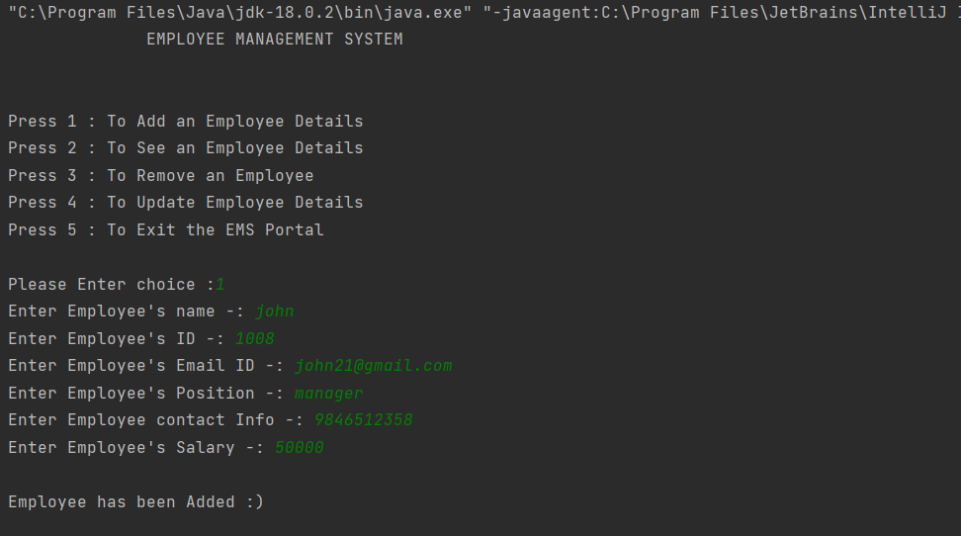
OUTPUT OF EMPLOYEE ADD

Slide 14
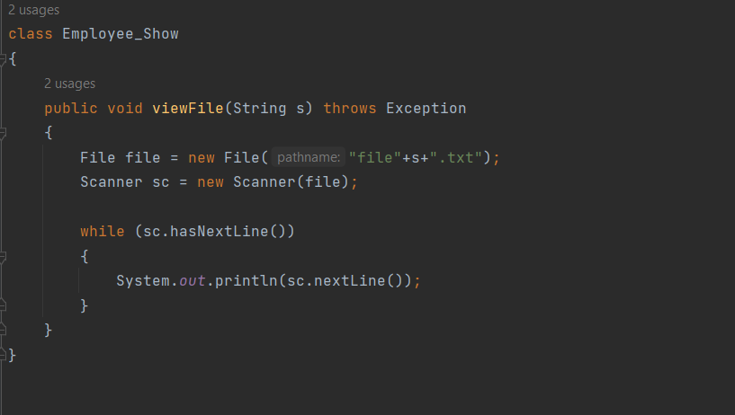
TO SHOW THE DETAILS OF EMPLOYEE

Slide 15
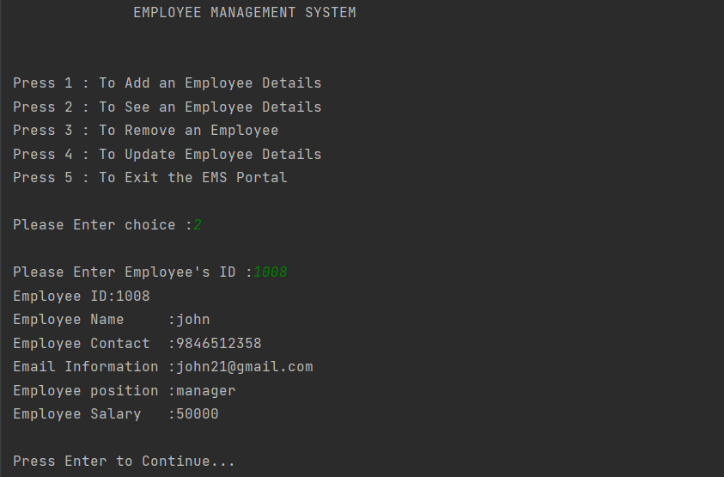
OUTPUT OF EMPLOYEE DETAILS

Slide 16
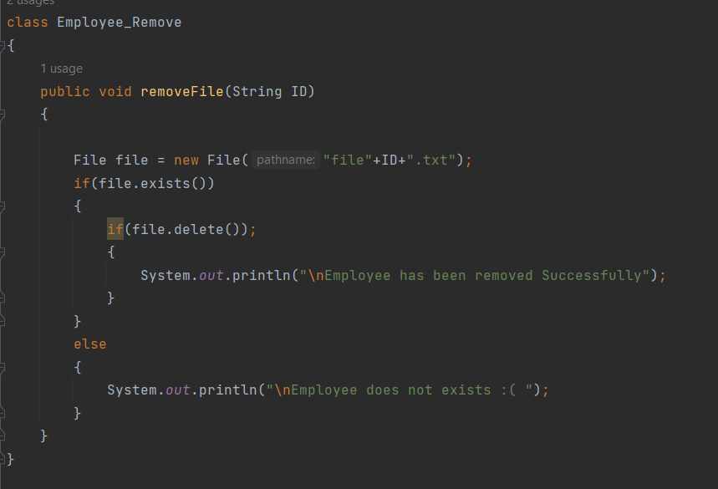
TO REMOVE AN EMPLOYEE DETAILS

Slide 17
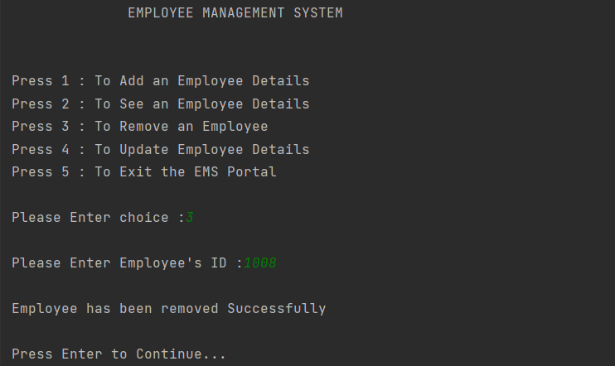
OUTPUT OF REMOVE AN EMPLOYEE

Slide 18
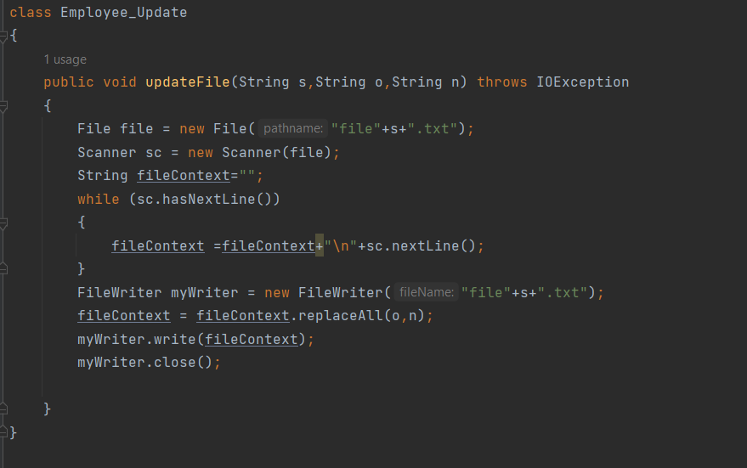
TO UPDATE EMPLOYEE DETAIL

Slide 19
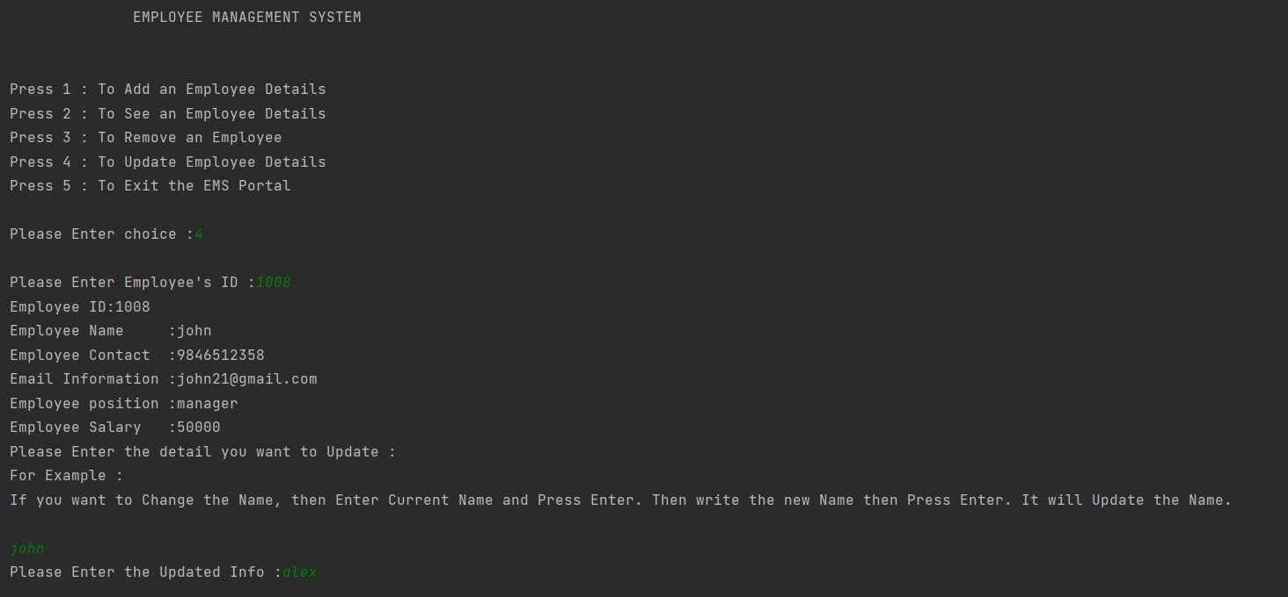
OUTPUT OF UPDATE DETAILS

Slide 20
5. PACKAGES AND FEATURES

Slide 21
PACKAGES USED
Java.Lang :
Provides classes that are fundamental to the design of the Java programming language. The most important classes are Object, which is the root of the class hierarchy, and Class, instances of which represent classes at run time and it is a default package in java.
Java.util :
It contains the collections of framework , legacy collection classes, event model, date and time facilities, internationalization, and miscellaneous utility classes .
Java.sql :
We have relational databases, from which at many times we need to access the data. For various data processing related matters from RDBMS we have java.sql package.

Slide 22
FEATURES OF EMPLOYEE MANGEMENT SYSTEM
Time and Attendance management.
Streamline Payroll.
Actual logs.
Accurate Timesheets.
Productivity insights.
Desktop screenshot.
Project and Task management.
Cloud Solution.

Slide 23
6.
CONCLUSION

Slide 24
Software for employee management systems helps your organization improve workforce productivity and boost overall well-being by tracking and monitoring the daily working activities of every employee. Desk track is the best employee productivity monitoring software for workforce management. It keeps track of every activity done by an employee during his working hours. As a result, if you are searching for the best employee productivity monitoring software then desk track has some impressive features that can be the best fit for your organization.

Slide 25
Thanks!
Any questions?

